Slide 1
Virtual Labs 3.0
Senior Project – Summer 2015
Crystal Rivera – Scrum Master/web developer
Johann Henao – Web developer
Daniel Gonzalez – backend developer
Juan Riano – backend developer
Trung Ngo – web developer
Mentor/product owner: Dr. Masoud Sadjadi

Slide 2
PROBLEM Definition
The current system is a Moodle based solution.
Services Provided:
- Quota System (Credit Types → Virtual lab resources)
- Quota Store (Online store → Products are Credit Types)
virtual labs resources are hosted in eFront.
Need to migrate the Quota Store to eFront as a module to keep all functions in the same system.
Need for DB referential integrity constrains.
Need for a DB management utility.

Slide 3
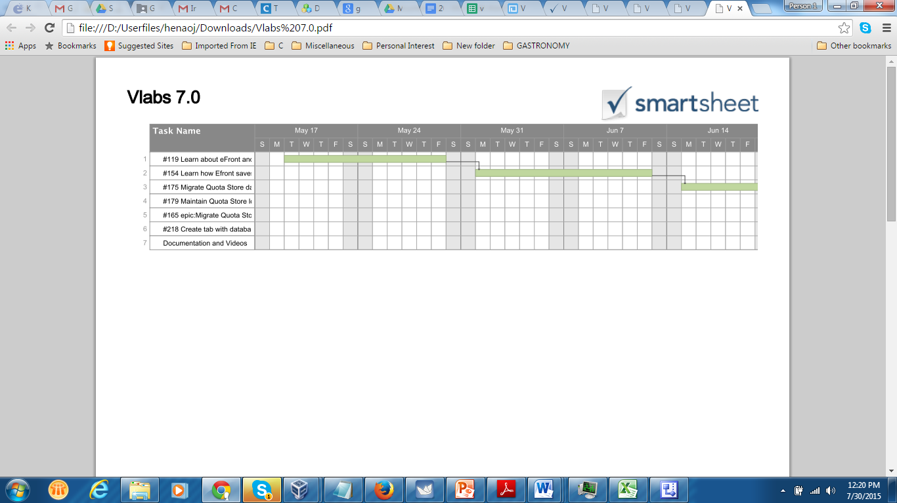
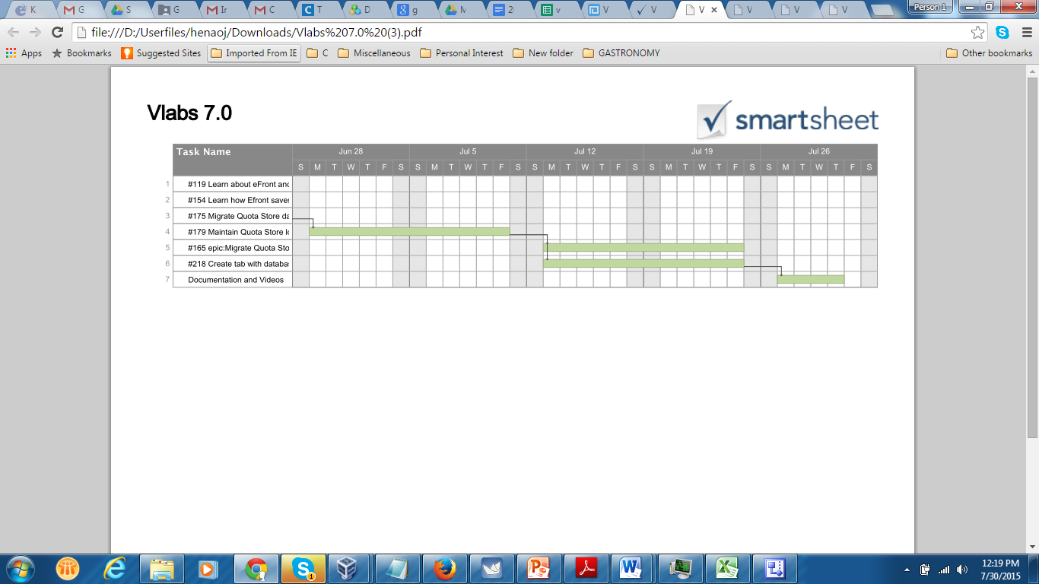
Project Management

Slide 4
Requirements
implemented use cases

Slide 5
Virtual Labs – implemented stories
#178 Migrate Quota Store "Orders Manager" tab UI functionality from Moodle to Efront.
#202 Migrate Quota Store "Store Manager" tab UI functionality from Moodle to Efront .
#203 Migrate Quota Store "Custom Packages" tab UI functionality from moodle to Efront.
#204 Migrate Quota Store "Pre-assignment" tab UI functionality from moodle to Efront.
#241 Migrate Quota Store "Shoppingcart - Store" tab UI functionality from Moodle to Efront
#243 Migrate Quota Store "Shoppingcart - Cart" tab UI functionality from Moodle to Efront
#179 Maintain Quota Store look and feel consistent with eFront and rest of vlabs modules.
#207 Automate the process of dumping and importing the data of the DB for the Quota Store module.
#206 Implement DB referential constraints for Quota Store tables.
#218 Create tab with database management functionality on Quota Store.

Slide 6
USE CASEs
Use Case 1
Name: | List Orders
Actor: | Administrator.
Pre condition: | Administrator logged in to eFront and clicked on the Quota Store Module.
Post condition: | Administrator is able to see the list of orders.
Success Scenario: | Administrator clicks on“Orders Manager” tab. Administrator is able to see the list of orders.
Exit condition: | Administrator clicks on Home or simply logs out of eFront.
Exceptions: | No tabs are displayed.
Use Case 2
Name: | Display order details.
Actor: | Administrator.
Pre condition: | Administrator logged in to eFront and clicked on the Quota Store Module.
Post condition: | Administrator is able to see the order detail.
Success Scenario: | Administrator clicks on“Orders Manager” tab. Administrator selects a particular table row and row slides down. Administrator clicks on “details” button. Administrator clicks on row returned. Row slides down and displays the order detail.
Exit condition: | Administrator clicks on “Back to Orders Manager”, “Home” or simply logs out of eFront.
Exceptions: | PHP un formatted error. This usually indicates that the connection to the soap service was unsuccessful.

Slide 7
Use cases
Use Case 3
Name: | Cancel Order
Actor: | Administrator.
Pre condition: | Administrator logged in to eFront and clicked on the Quota Store Module.
Post condition: | Administrator gets a msg indicating order was canceled.
Success Scenario: | Administrator clicks on“Orders Manager” tab. Administrator is able to see the list of orders. Administrator selects a particular row and row slides down. Administrator clicks “cancel” button”.
Exit condition: | Administrator clicks on Home or simply logs out of eFront.
Exceptions: | No tabs are displayed. Cancel action is unsuccessful due to network problems.
Use Case 4
Name: | Approve Order
Actor: | Administrator.
Pre condition: | Administrator logged in to eFront and clicked on the Quota Store Module.
Post condition: | Administrator gets a msg indicating order was approved and order status changes to “Fulfillment State”, “Approved”.
Success Scenario: | Administrator clicks on“Orders Manager” tab. Administrator is able to see the list of orders. Administrator selects a particular row which has “Fulfillment State” in “Pending Approval”status. Row slides down. Administrator clicks “Approve” button”.
Exit condition: | Administrator clicks on Home or simply logs out of eFront.
Exceptions: | No tabs are displayed. Approve action is unsuccessful due to network problems.

Slide 8
USECASE
Use Case 5
Name: | Add item to cart
Actor: | Student.
Pre condition: | Student logged in to eFront and clicked on Quota Store Module.
Post condition: | Student gets a msg indicating item was added to the cart.
Success Scenario: | Student clicks on“Store” tab. Student is able to see the list of items available. Student clicks on “Add to Cart” on the row item desired. Student receives a msg “Item added to cart”.
Exit condition: | Student clicks on Home or simply logs out of eFront.
Exceptions: | No tabs are displayed. Add Item action is unsuccessful due to network problems.
Use Case 6
Name: | Checkout Item
Actor: | Student.
Pre condition: | Student logged in to eFront and clicked on Quota Store Module.
Post condition: | Student gets a msg saying he/she will get an email with further details.
Success Scenario: | Student clicks on“Cart” tab. Student is able to see the list of items available. Student clicks “Checkout”. Student sees a description field to enter a description. Student clicks on “Place Order”. Student gets a msg “Thank you for “Thank your <student name> You will receive ane-mail to … with further details”.
Exit condition: | Student clicks on Home or simply logs out of eFront.
Exceptions: | No tabs are displayed. Add Item action is unsuccessful due to network problems.

Slide 9
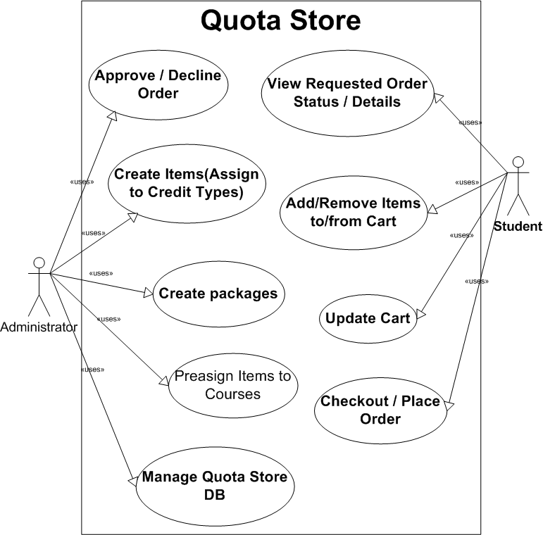
USE CASE DIAGRAM

Slide 10
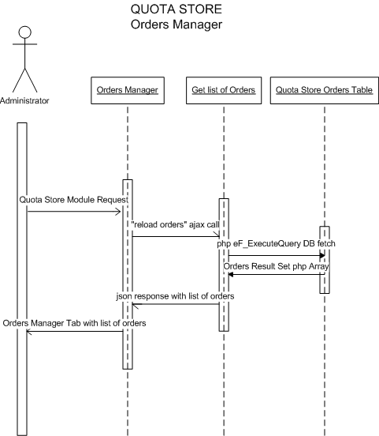
Sequence diagram

Slide 11
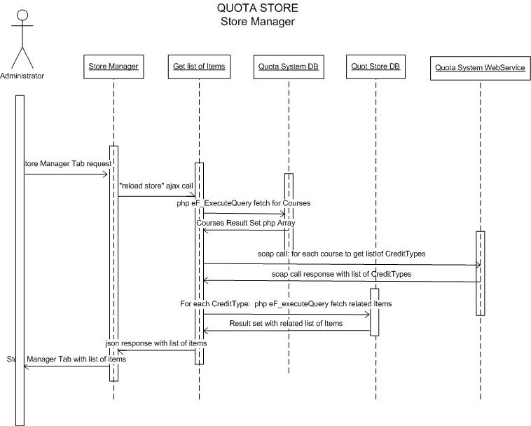
Sequence diagram

Slide 12
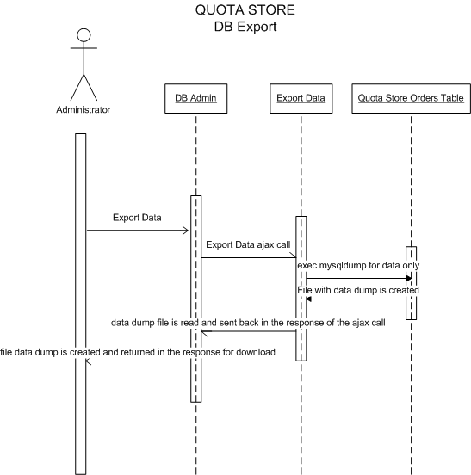

Slide 13
System design
Design & deployment

Slide 14
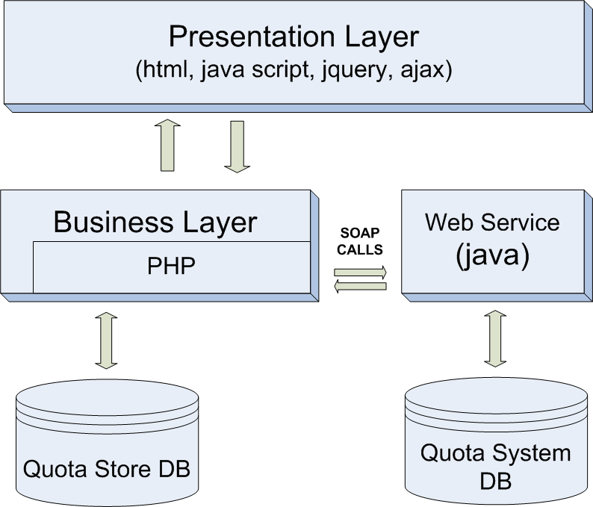
System decomposition
Quota Store is a Web solution based on a three tier design architecture.
Ajax is used at the presentation layer to interact with the business layer, while PHP is used at the business layer to interact with the Quota Store data layer. SOAP is used at the business logic layer to retrieve Credit type data from the Quota System.

Slide 15
System deployment
Hardware Requirements | Software Requirements
Client: 512 MB RAM Any Processor | Client: Web browser
Server: 1 GB RAM 40GB HDD Intel Core 2 Duo 10/100 Mb/s | Server: Apache2.4 Server with modules mbstring and soap enabled. Php 5 MySql Server 5.x eFront 3.6.x Quota System Module zip file Quota Store Module zip file

Slide 16
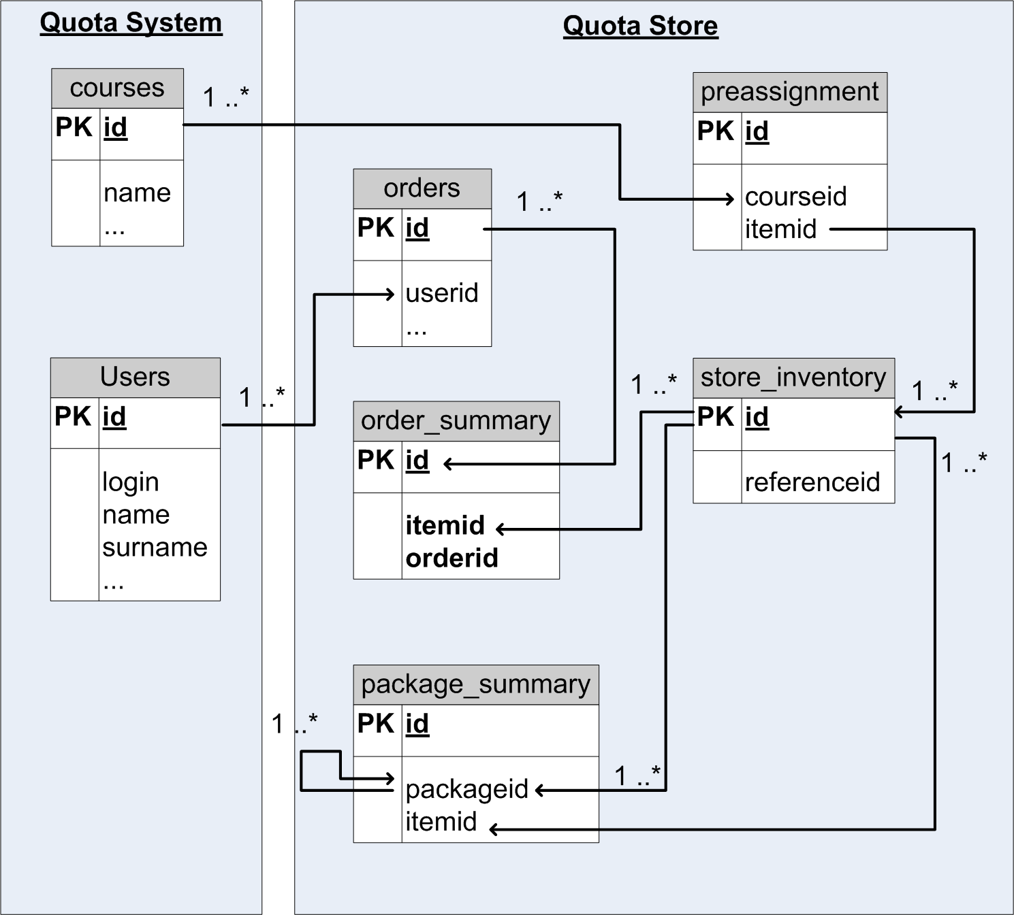
Persistent data
Quota Store data is stored in the same database as eFront. Each table name has the following prefix: “module_vlabs_”.
Referential constraints are enforced within the Quota Store tables.
Course and User information is fetched directly from the Quota System.

Slide 17
Security / privacy
Security of the Quota Store relies on eFront’s security design which requires a user to login.
Users in eFront can be created to belong to the following roles: “Administrators” or “Students”. The Quota Store code checks which role the user that’s using the system belongs to and depending on that it presents the user with the tabs and functionality that correspond to such role.

Slide 18
Detailed design
Class & object

Slide 19
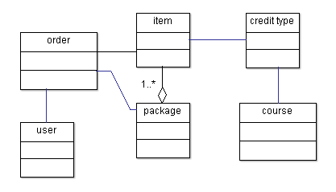
Minimal class diagram
When a user is enrolled in a course, he/she can order virtual labs resources “items” which can then be approved or denied by the administrator.
Items are individual “virtual lab” resources. Packages are composed of many items.
Items require to be associated to available Credit Types. Credit Types are associated to courses.

Slide 20
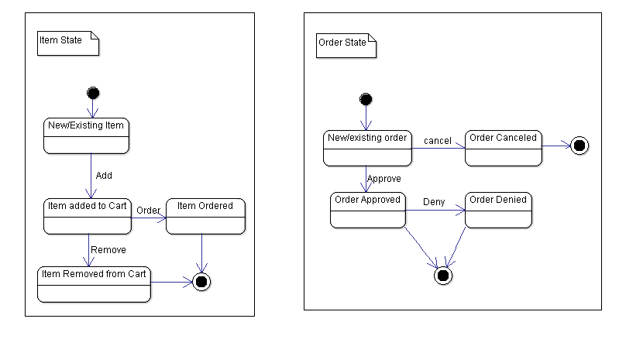
State machine

Slide 21
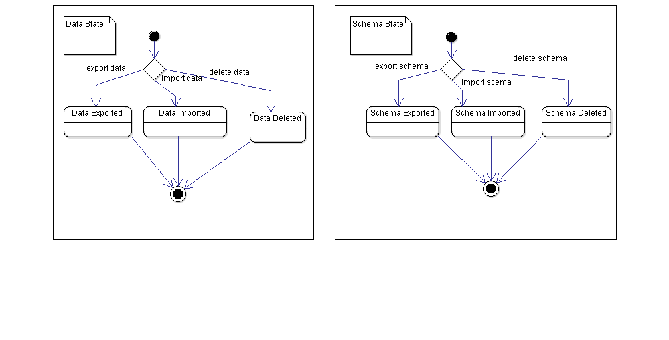
State machine

Slide 22
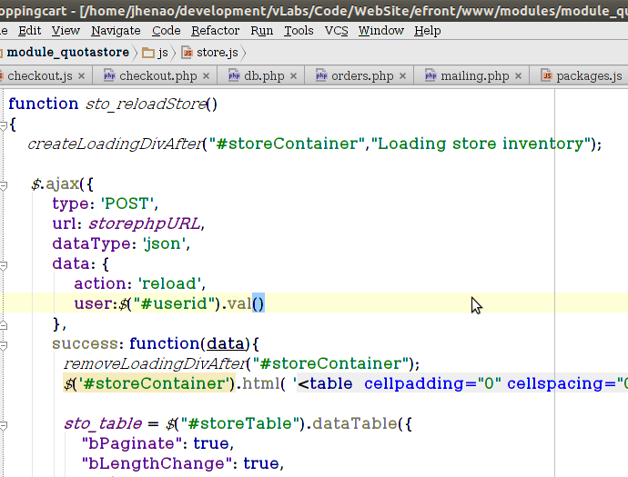
Main algorithm

Slide 23
verification
testing

Slide 24
testing
Functional tests were performed for all Use Cases of the Quota Store.
Regression testing was performed after adding new features to the solution and/or fixing software bugs.

Slide 25
demo

Slide 26
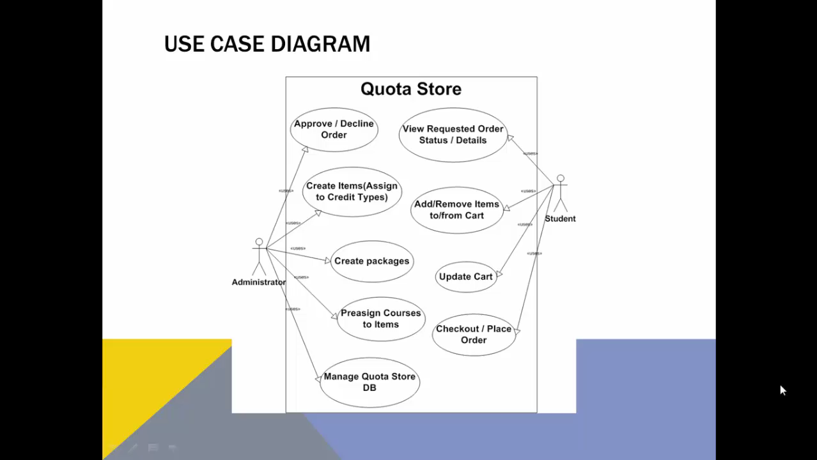
demo

